Slide 1
Social Connections
Rouslan Placella
Preslav Petkov
Gary Brady

Slide 2
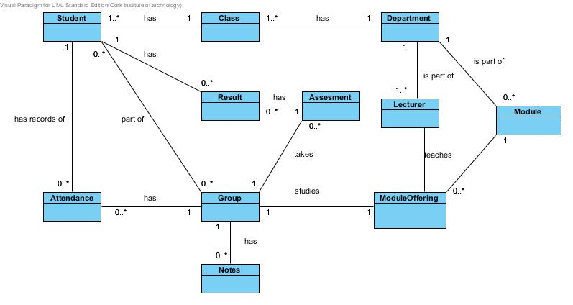
Domain Model

Slide 3
What it does
Takes attendance using face recognition
Manage Assessments
Manage Students
Manage Departments
Manage Groups
Manage Modules
Manage Notes
Communication
Manage Lecturers
Manage Classes
Set Threshold
Notifications/Email
Attendance Excuses
View Attendance
View Grant students

Slide 4
Architecture

Slide 5
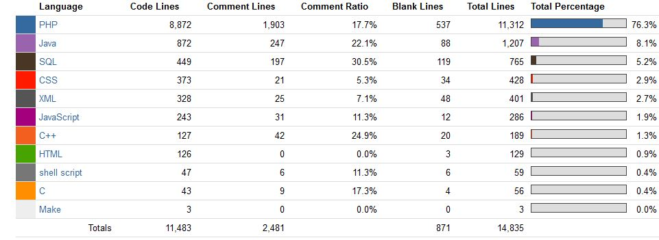
Programming Languages
Total lines of code: 15 000
Percentage of comments: 17%

Slide 6
PHP Framework
Internationalisation through gettext
TidyHTML
User management
Authentication
Mobile support
Security (SQL prepared statement, Rate limited login, Hashed and Salted, XSS protection)

Slide 7
PHP Class Diagram

Slide 8
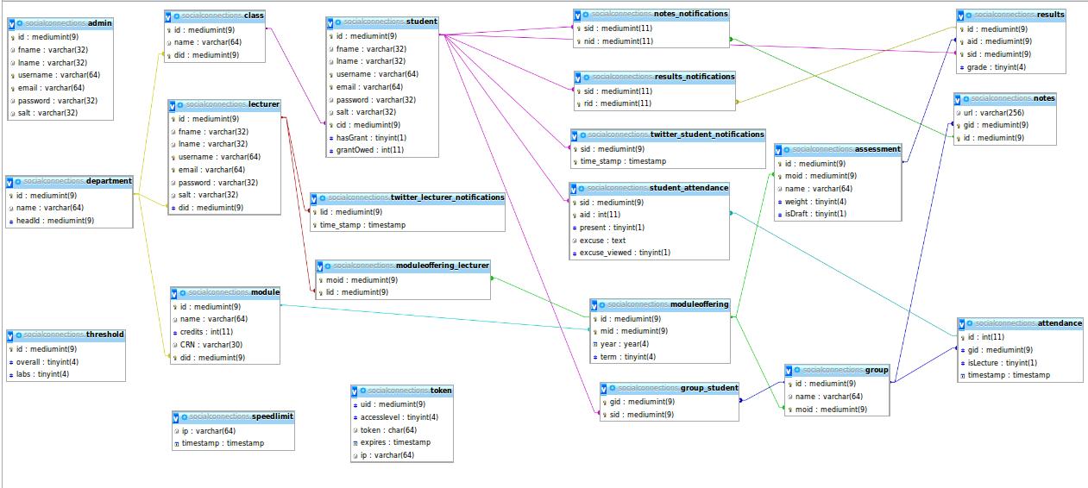
Database Model

Slide 9
HTML5
Screen capture/GIF

Slide 10

jQuery Mobile
Supported platforms

Slide 11
JAVA Class Diagram

Slide 12
Facial Recognition
Diagram

Slide 13
Dropbox/Twitter
Oauth (libraries)
Applications

Slide 14
Performance
Speed
Stress test
Handles 20 concurrent connections

Slide 15
Expandability
Configurable
Easily translatable
Easily deployed
Highly extendible

Slide 16
Communication
Meetings
Phone
Facebook
E-mail
IRC
Skype
Blog

Slide 17
Retrospective
XSRF tokens
fastCGI
Templates
Avatars
Improved Server Setup

Slide 18
Future prospects
Using the knowledge gained during the development of this project, we will set up a highly scalable, cloud based, pay as you go facial recognition system for the public.

Slide 19
Cost Analysis
Estimated value of project using the Basic COCOMO Model : €110,000 total
Estimated value of project, assuming minimum wage : €1557 total

